Slide 1
Polygons
Think – Pair – Share
What do you think a Polygon is?

Slide 2
A Polygon is...
…a 2-D shape made when line segments enclose a region.
A
An end point is called a vertex. Together they are called vertices.
B
The line segments are called sides.
E
C
D

Slide 3
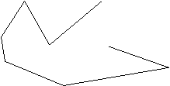
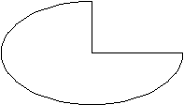
Which of these shapes are Polygons?

Slide 4
Polygons are named according to the number of sides they have?
Number of sides | Name of polygon
3
4
5
6
7
8
9
10
Triangle
Quadrilateral
Pentagon
Hexagon
Heptagon
Octagon
Nonagon
Decagon

Slide 5
Regular Polygon
A regular polygon has equal sides and equal angles.
Examples:

Slide 6
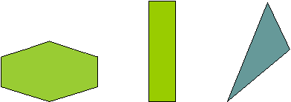
Irregular Polygon
An Irregular polygon does not have equal sides or equal angles.
Examples:

Slide 7
More interesting types of Polygons:
Shape Name: | Number of Sides:
Hendecagon | 11
Dodecagon | 12
Tridecagon | 13
Tetradecagon | 14
Pentadecagon (or Quindecagon) | 15
Hexadecagon | 16
Heptadecagon | 17
Octadecagon | 18
Enneadecagon (or Nonadecagon) | 19
Icosagon | 20

Slide 8
Polygon Song

Slide 9
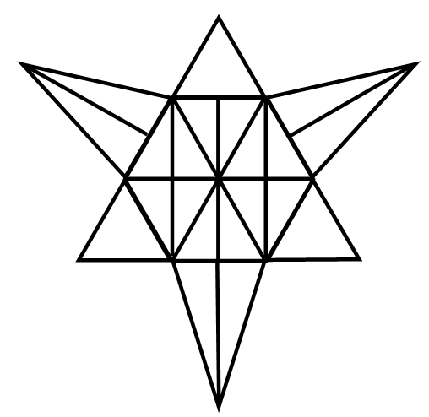
How Many Polygons can you see?

